Slide 1
Lecture 7: Spatio-temporal models
May 10, 2018

Slide 2
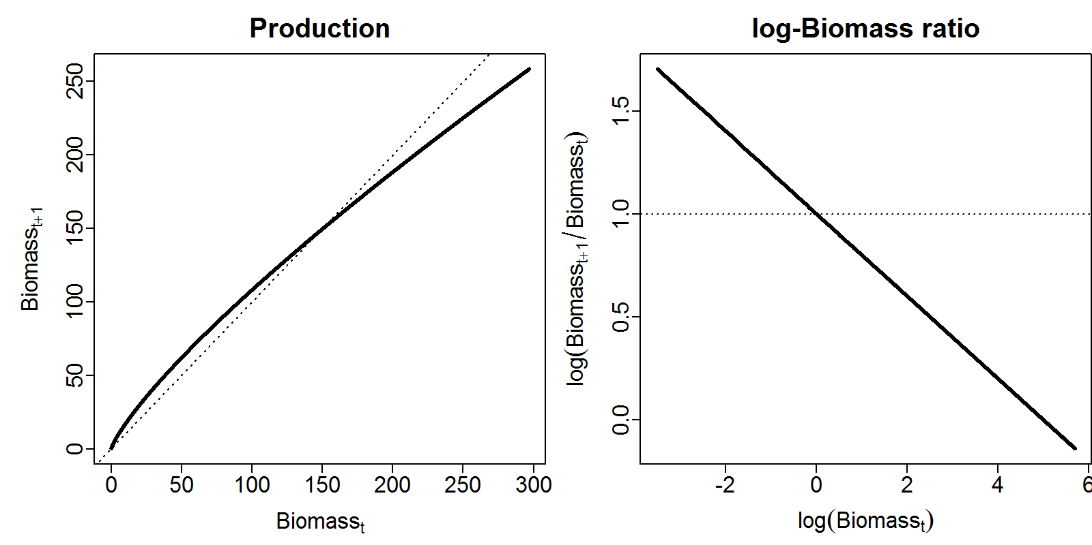

Gompertz model
$$d_{t}=\left\{\begin{matrix}\exp\left(\frac{α}{β}+φ\right)×exp⁡(ε_{t}) & if t=1 \\ d_{t−1}×exp⁡(α)×\exp\left(−β{log⁡(d}_{t−1})\right)×exp⁡(ε_{t}) & if t>1\end{matrix}\right.$$

Slide 3
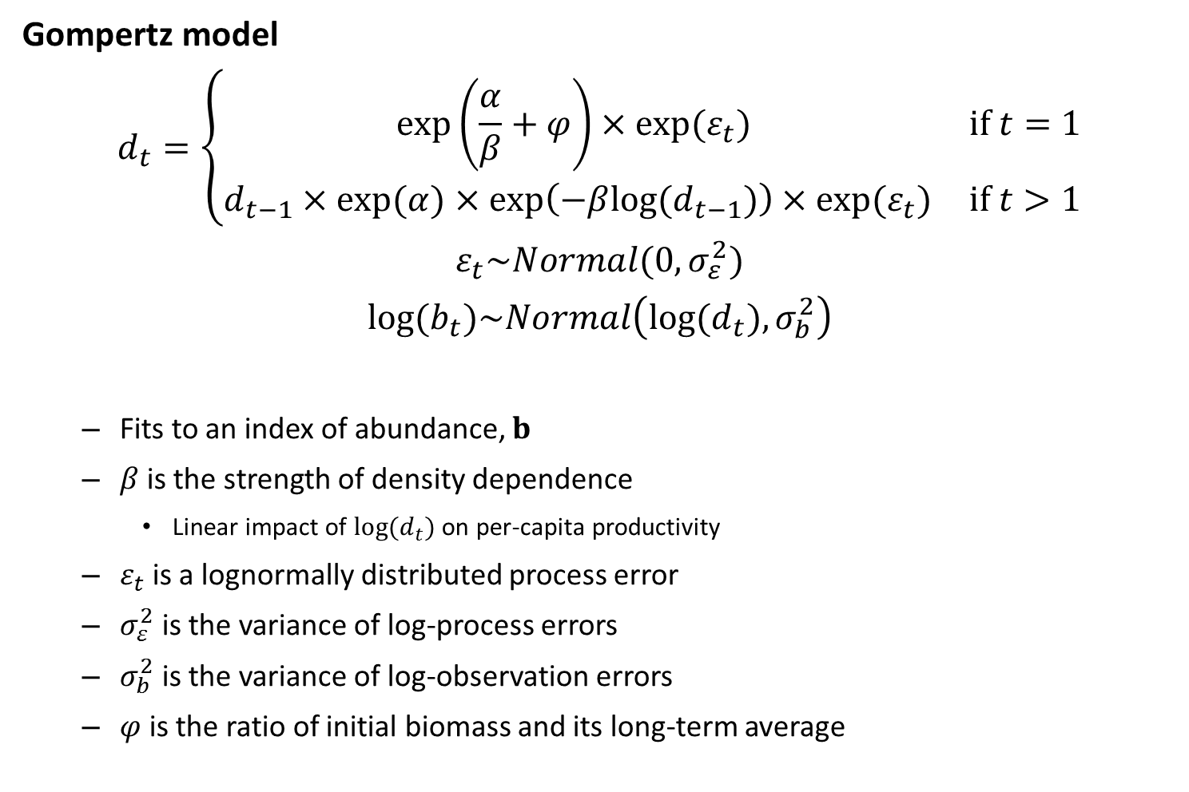
Gompertz model
$$d_{t}=\left\{\begin{matrix}\exp\left(\frac{α}{β}+φ\right)×exp⁡(ε_{t}) & if t=1 \\ d_{t−1}×exp⁡(α)×\exp\left(−β{log⁡(d}_{t−1})\right)×exp⁡(ε_{t}) & if t>1\end{matrix}\right.$$
$$ε_{t}\sim Normal(0,σ_{ε}^{2})$$
$$log⁡(b_{t})\sim Normal\left(log⁡(d_{t}),σ_{b}^{2}\right)$$
Fits to an index of abundance, $b$
$β$ is the strength of density dependence
Linear impact of ${log⁡(d}_{t})$ on per-capita productivity
$ε_{t}$ is a lognormally distributed process error
$σ_{ε}^{2}$ is the variance of log-process errors
$σ_{b}^{2}$ is the variance of log-observation errors
$φ$ is the ratio of initial biomass and its long-term average

Slide 4
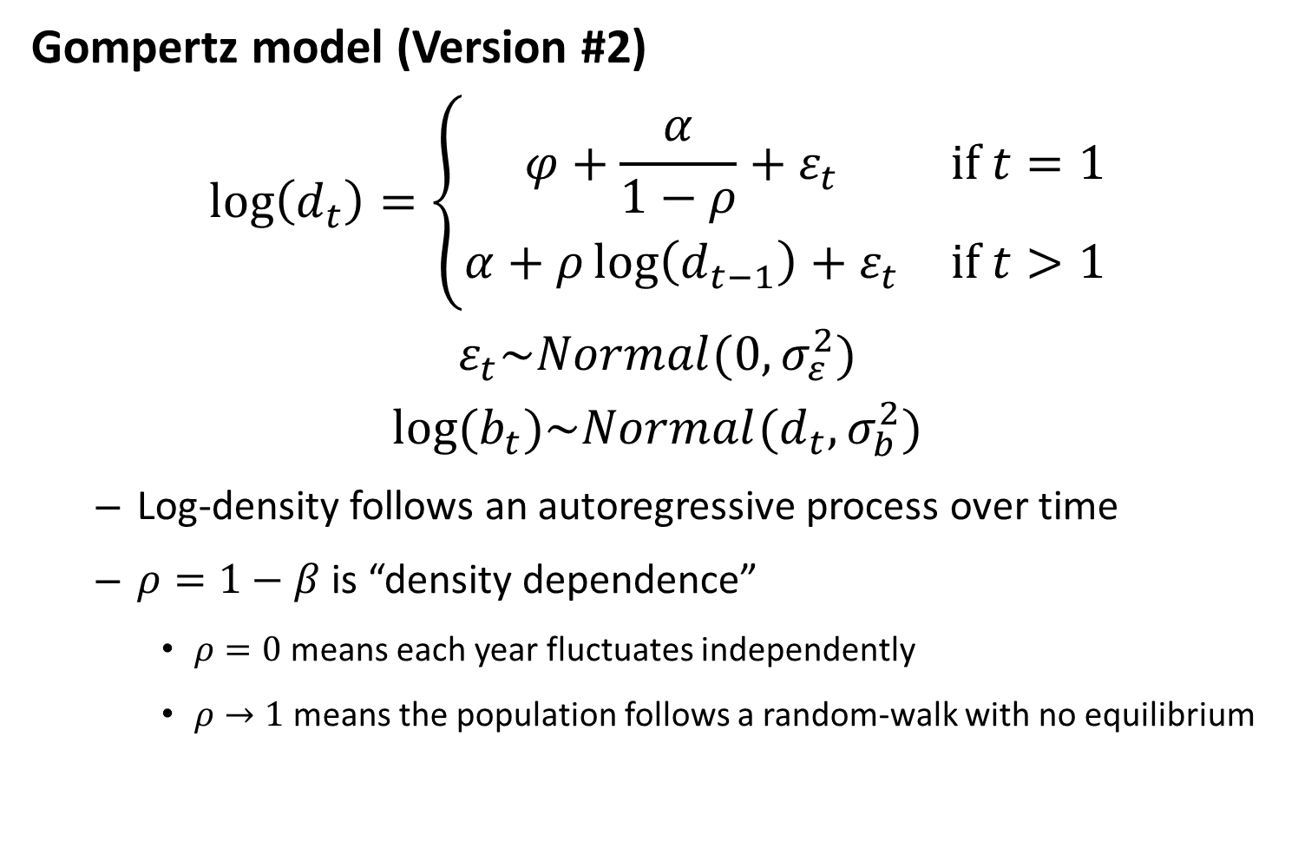
Gompertz model (Version #2)
$$\log\left(d_{t}\right)=\left\{\begin{matrix}φ+\frac{α}{1−ρ}+ε_{t} & if t=1 \\ α+ρ\log\left(d_{t−1}\right)+ε_{t} & if t>1\end{matrix}\right.$$
$$ε_{t}\sim Normal(0,σ_{ε}^{2})$$
$$log⁡(b_{t})\sim Normal(d_{t},σ_{b}^{2})$$
Log-density follows an autoregressive process over time
$ρ=1−β$ is “density dependence”
$ρ=0$ means each year fluctuates independently
$ρ→1$ means the population follows a random-walk with no equilibrium

Slide 5

Gompertz model (version #3)
$$log(d)=φρ^{t−1}+α+ε$$
$$ε\sim MVN(0,σ_{ε}^{2}R)$$
$$log⁡(b)\sim MVN(d,σ_{b}^{2}I)$$
Where $R$ is the correlation matrix for an AR1 process

Slide 6
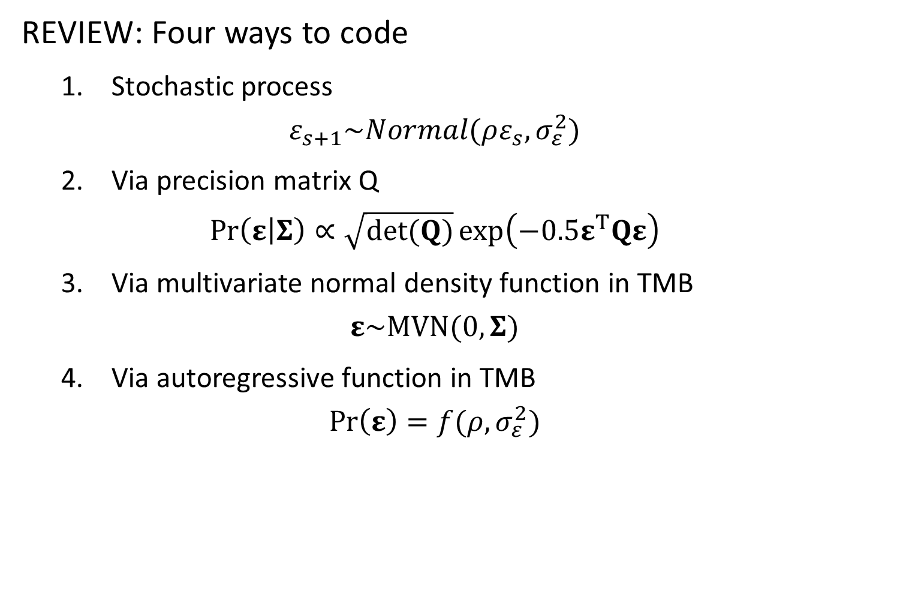
REVIEW: Four ways to code
1. Stochastic process
$$ε_{s+1}\sim Normal(ρε_{s},σ_{ε}^{2})$$
2. Via precision matrix Q
$$\operatorname{Pr}\left(ε | Σ\right)∝\sqrt{det(Q)}\exp\left(−0.5ε^{T}Qε\right)$$
3. Via multivariate normal density function in TMB
$$ε\sim MVN(0,Σ)$$
4. Via autoregressive function in TMB
$$Pr\left(ε\right)=f(ρ,σ_{ε}^{2})$$

Slide 7
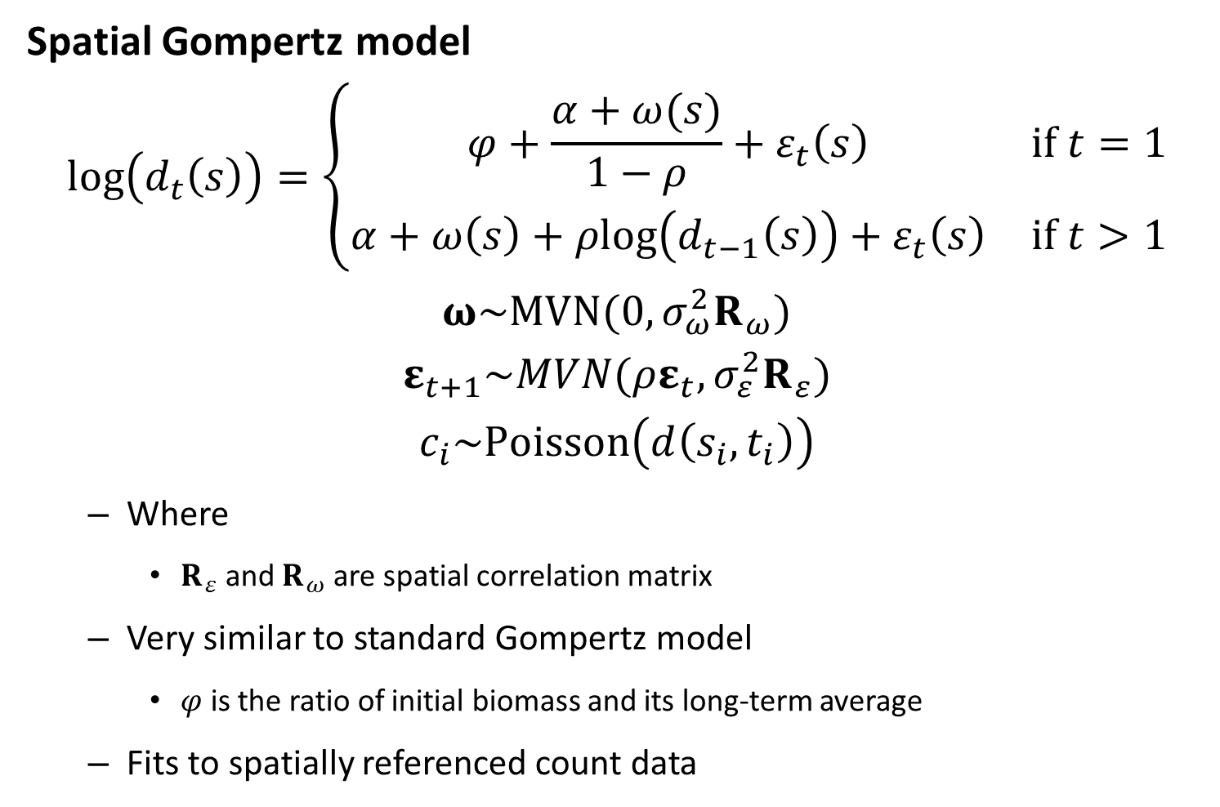
Spatial Gompertz model
$$log\left(d_{t}\left(s\right)\right)=\left\{\begin{matrix}φ+\frac{α+ω(s)}{1−ρ}+ε_{t}\left(s\right) & if t=1 \\ α+ω\left(s\right)+ρlog⁡\left(d_{t−1}\left(s\right)\right)+ε_{t}\left(s\right) & if t>1\end{matrix}\right.$$
$$ω\sim MVN(0,σ_{ω}^{2}R_{ω})$$
$$ε_{t+1}\sim MVN(ρε_{t},σ_{ε}^{2}R_{ε})$$
$$c_{i}\sim Poisson\left(d\left(s_{i},t_{i}\right)\right)$$
Where
$R_{ε}$ and $R_{ω}$ are spatial correlation matrix
Very similar to standard Gompertz model
$φ$ is the ratio of initial biomass and its long-term average
Fits to spatially referenced count data

Slide 8

Spatial Gompertz model
$$log\left(d_{t}\left(s\right)\right)=\left\{\begin{matrix}φ+\frac{α+ω(s)}{1−ρ}+ε_{t}\left(s\right) & if t=1 \\ α+ω\left(s\right)+ρlog⁡\left(d_{t−1}\left(s\right)\right)+ε_{t}\left(s\right) & if t>1\end{matrix}\right.$$
$$ω\sim MVN(0,σ_{ω}^{2}R_{ω})$$
$$ε_{t+1}\sim MVN(ρε_{t},σ_{ε}^{2}R_{ε})$$
Implications
Expectation:
$$𝔼_{s,t}\left(\log\left(d\right)\right)=\frac{α}{1−ρ}$$
$$𝔼_{t}\left(\log\left(d\left(s\right)\right)\right)=\frac{α+ω(s)}{1−ρ}$$
Variance
$$𝕍_{s,t}\left(log⁡(d)\right)=σ_{ω}^{2}+\frac{σ_{ε}^{2}}{1−ρ^{2}}$$
$$𝕍_{t}\left(\log\left(d\left(s\right)\right)\right)=\frac{σ_{ε}^{2}}{1−ρ^{2}}$$

Slide 9


Spatial Gompertz model:
Can use same trick as “Gompertz model version #3”
$$c_{i}\sim Poisson(exp⁡(d(s_{i},t_{i})))$$
$$d_{t}=φρ^{t−1}+α+ω+ε_{t}$$
$$ω\sim MVN(0,\frac{σ_{ω}^{2}}{1−ρ}R_{ω})$$
$$vec(Ε)\sim MVN(0,σ_{ε}^{2}R_{ε}⊗R_{t})$$
Where $R$ is the correlation matrix for 1st order autocorrelation
$$R_{t}=\left[\begin{matrix}1 & ρ & ρ^{2} & ... & ρ^{T−1} \\ ρ & 1 & ρ & ... & ρ^{T−2} \\ ρ^{2} & ρ & 1 & ... & ρ^{T−3} \\ ... & ... & ... & ... & ... \\ ρ^{T−1} & ρ^{T−2} & ρ^{T−3} & ... & 1\end{matrix}\right]$$

Slide 10
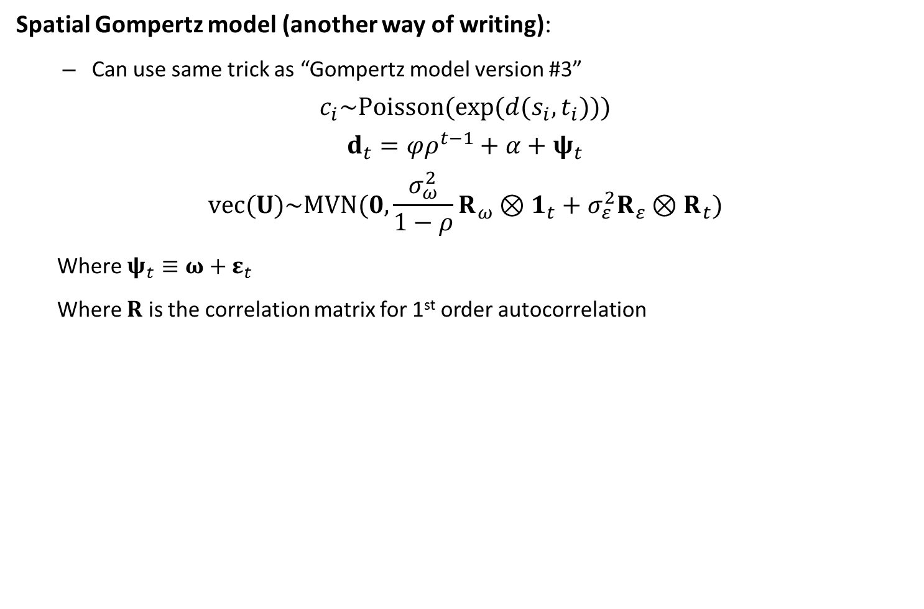
Spatial Gompertz model (another way of writing):
Can use same trick as “Gompertz model version #3”
$$c_{i}\sim Poisson(exp⁡(d(s_{i},t_{i})))$$
$$d_{t}=φρ^{t−1}+α+ψ_{t}$$
$$vec(U)\sim MVN(0,\frac{σ_{ω}^{2}}{1−ρ}R_{ω}⊗1_{t}+σ_{ε}^{2}R_{ε}⊗R_{t})$$
Where $ψ_{t}≡ω+ε_{t}$
Where $R$ is the correlation matrix for 1st order autocorrelation
$$R_{t}=\left[\begin{matrix}1 & ρ & ρ^{2} & ... & ρ^{T−1} \\ ρ & 1 & ρ & ... & ρ^{T−2} \\ ρ^{2} & ρ & 1 & ... & ρ^{T−3} \\ ... & ... & ... & ... & ... \\ ρ^{T−1} & ρ^{T−2} & ρ^{T−3} & ... & 1\end{matrix}\right]$$

Slide 11
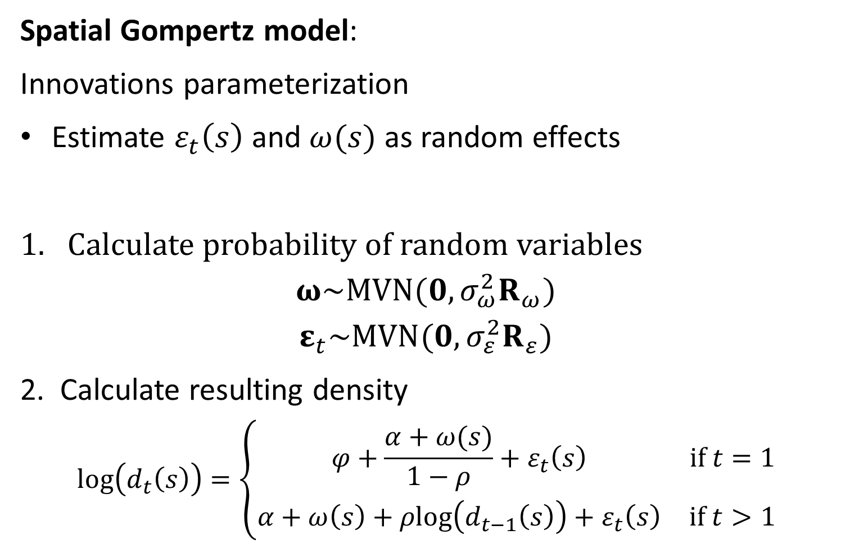
Spatial Gompertz model:
Innovations parameterization
Estimate $ε_{t}\left(s\right)$ and $ω(s)$ as random effects
Calculate probability of random variables
$$ω\sim MVN(0,σ_{ω}^{2}R_{ω})$$
$$ε_{t}\sim MVN(0,σ_{ε}^{2}R_{ε})$$
2. Calculate resulting density
$$log\left(d_{t}\left(s\right)\right)=\left\{\begin{matrix}φ+\frac{α+ω(s)}{1−ρ}+ε_{t}\left(s\right) & if t=1 \\ α+ω\left(s\right)+ρlog⁡\left(d_{t−1}\left(s\right)\right)+ε_{t}\left(s\right) & if t>1\end{matrix}\right.$$

Slide 12
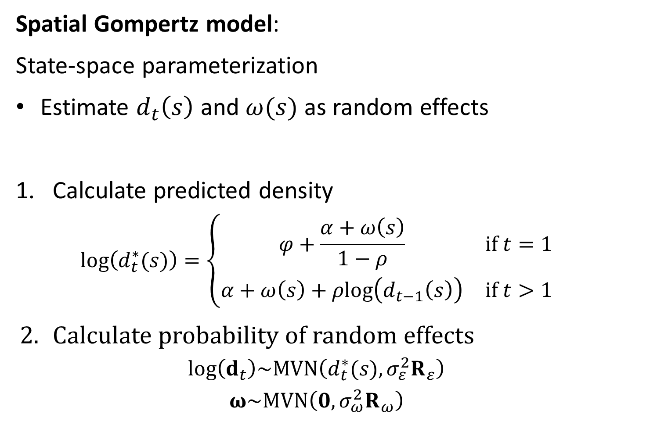
Spatial Gompertz model:
State-space parameterization
Estimate $d_{t}\left(s\right)$ and $ω(s)$ as random effects
Calculate predicted density
$$log⁡\left(d_{t}^{∗}(s)\right)=\left\{\begin{matrix}φ+\frac{α+ω\left(s\right)}{1−ρ} & if t=1 \\ α+ω\left(s\right)+ρlog⁡\left(d_{t−1}\left(s\right)\right) & if t>1\end{matrix}\right.$$
Calculate probability of random effects
$$log⁡\left(d_{t}\right)\sim MVN\left(d_{t}^{∗}(s),σ_{ε}^{2}R_{ε}\right)$$
$$ω\sim MVN\left(0,σ_{ω}^{2}R_{ω}\right)$$

Slide 13
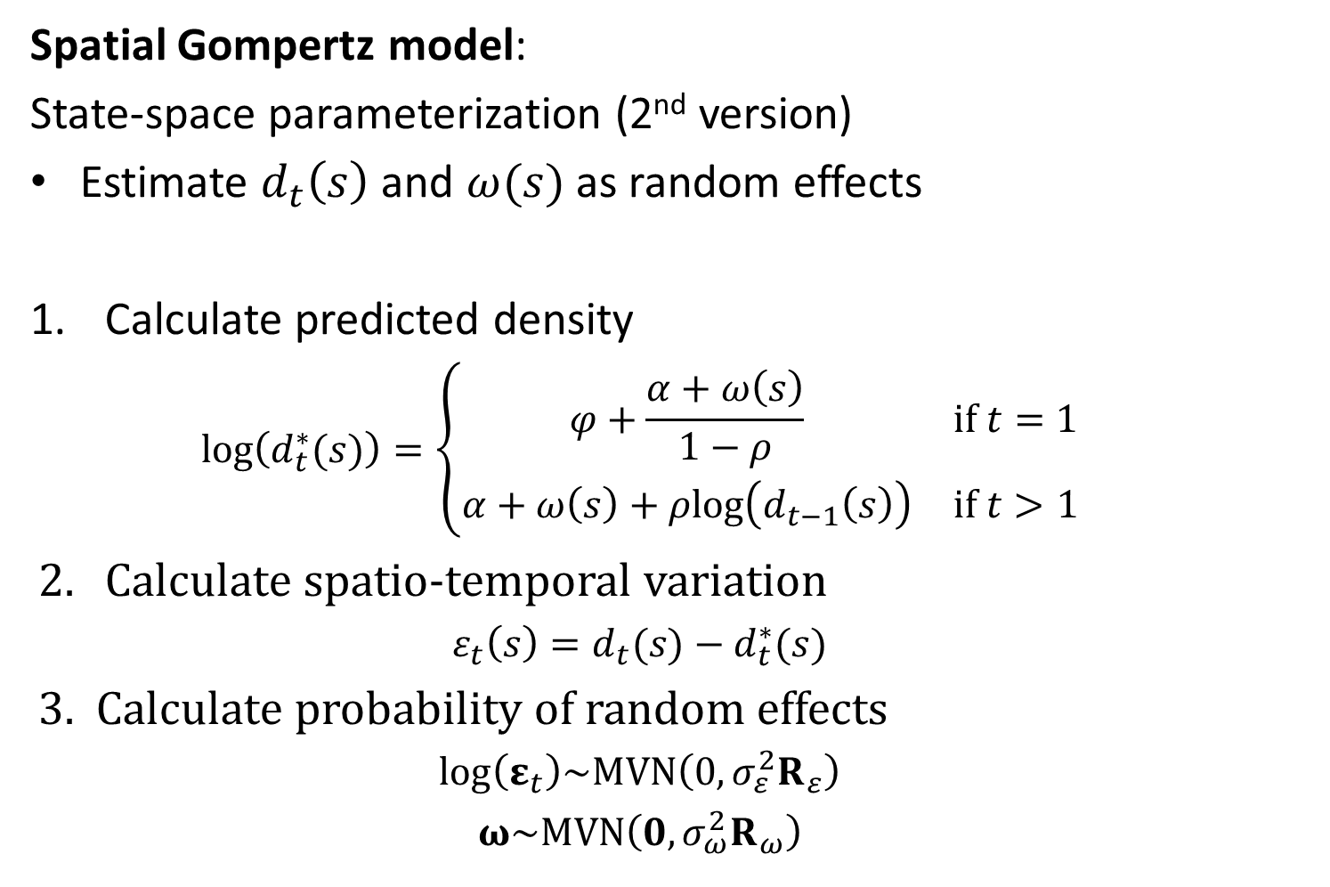
Spatial Gompertz model:
State-space parameterization (2nd version)
Estimate $d_{t}\left(s\right)$ and $ω(s)$ as random effects
Calculate predicted density
$$log⁡\left(d_{t}^{∗}(s)\right)=\left\{\begin{matrix}φ+\frac{α+ω\left(s\right)}{1−ρ} & if t=1 \\ α+ω\left(s\right)+ρlog⁡\left(d_{t−1}\left(s\right)\right) & if t>1\end{matrix}\right.$$
Calculate spatio-temporal variation
$$ε_{t}\left(s\right)=d_{t}(s)−d_{t}^{∗}(s)$$
3. Calculate probability of random effects
$$log⁡\left(ε_{t}\right)\sim MVN\left(0,σ_{ε}^{2}R_{ε}\right)$$
$$ω\sim MVN\left(0,σ_{ω}^{2}R_{ω}\right)$$

Slide 14
What to do if you have 1000s of unique locations?
Make sure your model is optimized
Sparseness
Only bias-correct variables you need
Normalize GMRFs only when doing outer optimization (details not shown)
Choose a new approximation to your dynamic process
Get a bigger computer
TMB allows parallelization
Decrease spatial resolution
Define number of “knots”
Run k-means algorithm to identify placement of knots
Minimize distance between locations and nearest knot
Associate each sample with the nearest knot
Assumes that density is constant at finer scales than the distance between knots
Run in batches
Run model on smaller scales
Run “meta-analysis” model on results from each small-scale model

Slide 15
In-class exercise:
Modify simulator to simulate density on a 100x100 grid
Sampling occurs in 100 randomly sampled grid cells in each year
Add code to visualize density generated by simulator
Add code to visualize estimated density for spatial Gompertz model
Explore how estimation performance changes when increasing/decreasing the spatial resolution in the simulator

